Slide 1
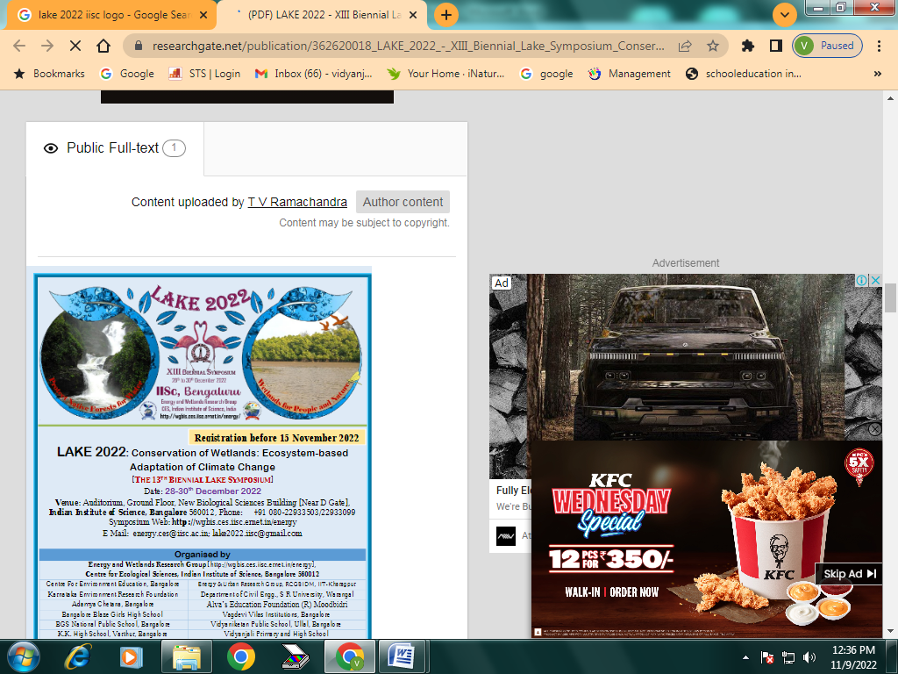

LAKE CONFERENCE 2022
Bloomed Flowers around Weavers Colony and on the bund of Billawaradhalli Lake
Team
Kanishka D Monika M. Class -8

Slide 2
INTRODUCTION:
Flower is the specialized part of an angiosperms plant that occurs singly or in clusters, possesses whorls of often colorful petals or sepals, and bears the reproductive structures (such as stamens or pistils) involved in the development of seeds and fruit.
One of the primary purpose of a flower is reproduction. Since, they are the reproductive organs of plants.
They meditate the joining sperm, contained within pollen, to the ovules in the ovary.
Pollination is the movement of pollen from the anther to stigma.

Slide 3
OBJECTIVE:
To record Bloomed Flowers around Weavers Colony and on the bund of Billawaradhalli Lake.

Slide 4
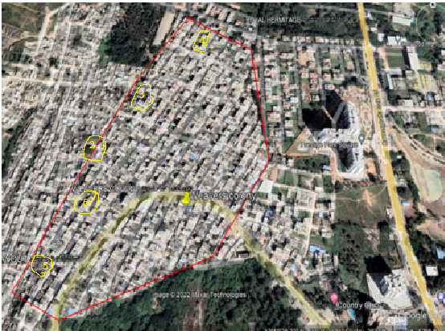
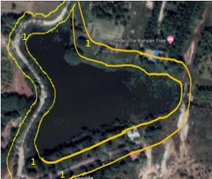
STUDY AREA:
Weavers colony
N
Billawaradhalli lake
Study Site:
Sl No | Site | Latitude | Longitude | Study Place
1 | Billawaradhalli lake | 12°83'29"N | 77°57'50"E | Lake bund
2 | Weavers colony 12th Cross | 12°84'76"N | 77°57'99"E | BMTC Depot area
3 | Weavers colony 11th Cross | 12°84'55"N | 77°58'22"E | Open yard
4 | Weavers colony 8th Cross | 12°84'35"N | 77°58'21"E | Shiva temple
5 | Weavers colony 9th Cross | 12°84'82"N | 77°58'48"E | Open yard
6 | Weavers colony 10th Cross | 12°84'82"N | 77°58'43"E | Open yard

Slide 5
MATERIALS AND METHODS:
Selected study area is around 3 km sq
visited the Study area weekly once in September and October-2022. In-between 8am to 10am.
Randomly inspecting 3 feet, both the side of the bund area of Billawaradhalli Lake and open yard of other study area Weavers Colony

Slide 6
Bloomed Flowers found month wise
SL NO | MONTH | SPECIES
 |  | Billawaradhahalli Lake bund | Weavers Colony
1 | September | 21 | 7
2 | October | 18 | 8

Slide 7
RESULTS AND DISCUSSION:
Totally 30 species of Bloomed flowers belonging to 18 families were identified in the study.
9 species in weavers colony and 21 species in Billawaradhalli lake bund.
We found more bloomed flowers in Billawaradhahalli lake bund due to less human activities and natural habitat
Flower seen in Billawaradhahalli lake bund and in 12th cross are not seen in other study sites because of concrete and black topping roads with less space for the plants to grow.

Slide 8
Flowers Found on The Bund of Billawaradhahalli Lake and 12th Cross Weavers colony
Sl No | Common / Vernicular Name | Scientific Name | Family | Sept | Oct
1 | Black - eyed susan vine | Thunbergia alata | Acanthaceae | 5 | 13
2 | Neelambari hoovu | Barleria cristata | Acanthaceae | 4 | 0
3 | Honaganne soppu | Alternanthera sessilis | Amaranthaceae | 11 | 15
4 | Nithya kalyani | Catharanthus roseus | Apocynaceae | 7 | 8
5 | Sulfur cosmos | Cosmos sulphureus | Asteraceae | 8 | 5
6 | Singapore daisy | Sphagneticola trilobata | Asteraceae | 15 | 20
7 | Kaamgressu gida | Parthenium hysterophorus | Asteraceae | 7 | 15
8 | Karana kundala | Impatiens blasamina | Balsaminaceae | 6 | 3
9 | Gauri beeja | Ipomoea nil | Convolvulaceae | 30 | 50
10 | Bekkina hejje balli | Ipomoea cairica | Convolvulaceae | 30 | 15
11 | Aiea morning glory | Ipomoea triloba | Convolvulaceae | 5 | 0
12 | Bush morning glory | Ipomoea carnea | Convolvulaceae | 3 | 7
13 | Red morning glory | Ipomoea coccinea | Convolvulaceae | 2 | 15
14 | Mullina kireeta | Euphorbia milii | Euphorbiaceae | 6 | 11
15 | Muttidhare muni | Mimosa pudica | Fabaceae | 5 | 7
16 | Daasavaala | Hibiscus Sp. | Mallows | 2 | 8
17 | Paper hoovu | Bougainvillea glabra | Nyctaginaceae | 55 | 70
18 | Dhundu mallige | Jasminum sambac | Oleaceae | 1 | 0
19 | Ummate | Datura metel | Solanaceae | 5 | 7
20 | Chilean potato tree | Solanum crispum | Solanaceae | 10 | 25
21 | Kakke/ Natahu | Lantana camara | Verbenaceae | 80 | 60

Slide 10
Flowers Found In Weavers Colony 8th, 9th, 10th and 11th Cross
SL NO | Common Name | Scientific Name | Family | Sept | Oct
1 | Kanakambara | Crossandra infundibuliformos | Acanthaceae | 8 | 12
2 | Show gida | Spathiphyllum wallisii | Araceae | 2 | 1
3 | Brahma kamala | Epiphyllum oxipetalum | Cactaceae | 6 | 2
4 | Chendu hoovu | Tagetes Sp. | Daisy family | 4 | 10
5 | Grassy tarweed | Madia gracilis | Daisy family | 0 | 1
6 | Aambrike hoovu | Senna occidentalis | Fabaceae | 5 | 0
7 | Thumbe | Leucas Sp. | Laminaceae | 0 | 15
8 | Hethuthi | Sida rhombifolia | Malvaceae | 2 | 6
9 | Marvel | Mirabilis jalapa | Nyctaginaceae | 1 | 5

Slide 12
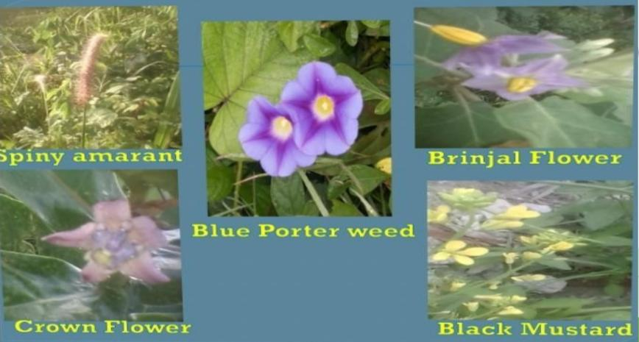
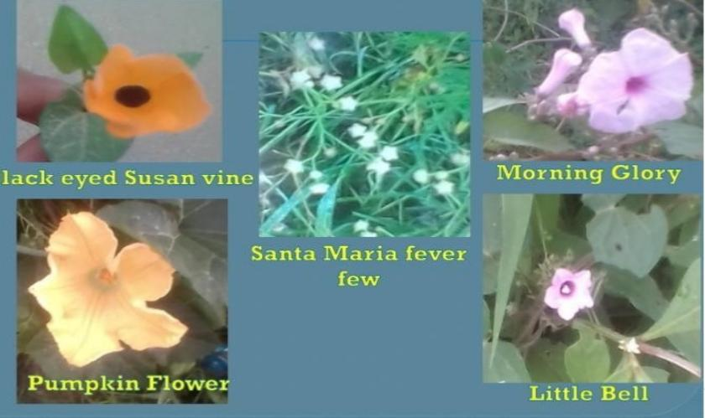
IDENTIFIED FLOWERS :
Japanese morning glory
Chilean potato tree
Alternanthera sessilis

Slide 13
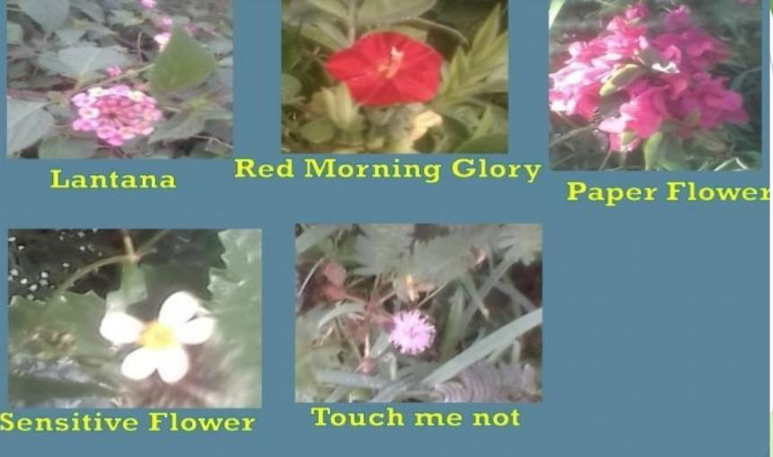
West Indian lantana
Ipomoea coccinea
Ipomoea carnea
Black eyed susan vine
Shame plant
Bougainvillea glabra

Slide 14
CONCLUSION:
Santa Maria fever few and shame plant are the flowers were found everywhere in both the study area.
More flowers were found in September month.
In October we found 26 species may be due to the human activities and weather change.
Flowers take prominent role in food web as it is attracted by it’s colour, structure and fragrance.
Flower serve as food, medicine source to living organism..
As it helps in reproduction, resulting the plants to take in carbon dioxide and release oxygen as plants.

Slide 15
ACKNOWLEDGEMENT
We thank our H.M, Guide Teacher for allowing us to conduct the Study.
We thank Energy and Wetland Research Group,
Center for Ecology Sciences, Indian Institute of Science. Bangalore,
Shri Vriju lal of CEE and Shri Cheturved Seit for guiding.
We thank one and all here for giving us opportunity to present the Study.

Slide 16
REFERENCE:
Harish Bhat et all (2015) A Brochure of Eyes on Nature published by Karnataka State Council for Science and Technology
www.Flowers of India. Net
Springer .com
For scientific name Wikipedia

Slide 17
THANK YOU

